Slide 1
Is the global financial system aligned with the SDGs?
Prof Mark Swilling
Centre for Sustainability Transitions, South Africa
Prof Helga Weisz, Potsdam Institute for Climate Impact Research, Germany

Slide 2
Transition capital needed
We need a 4x increase to $2,4 trillion annually by 2030 to capture climate and nature opportunities in emerging and developing economies (all EMDC’s except China)
With SDGs this need is an added $3trillion total $5,4 trillion
Climate and Nature: 2,4 trillion every year from 2030 onwards
  Of which:
    Energy transition: $1,6 trillion
    Adaptation and resilience: $250 billion
    Loss and damage $250 billion
    Nature capital and sustainable agriculture: $300 billion
    Social transition costs: $40 billion
  Other SDGs: $3 trillion
  (Source: Stef Raubenheimer)

Slide 3
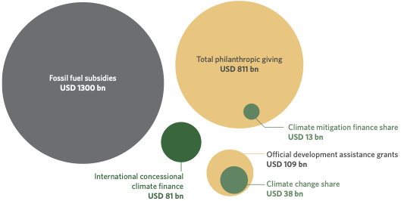
Where does the money come from?
Global ODA and grants: down 7% from 2023 to $212bn and falling; aid to Africa around $60bn
Climate Funds:
  Adaptation Fund: has committed $1,2bn since 2010, holds in the $100ms range
  Green Climate Fund: has disbursed $13,5bn
  CIFs: have pledged over $8bn, with $65bn co-financing
  All concessional climate financing around $80bn in 2022
50% of all savings in the hands of
60 million millionares (10% of pop)

Slide 4
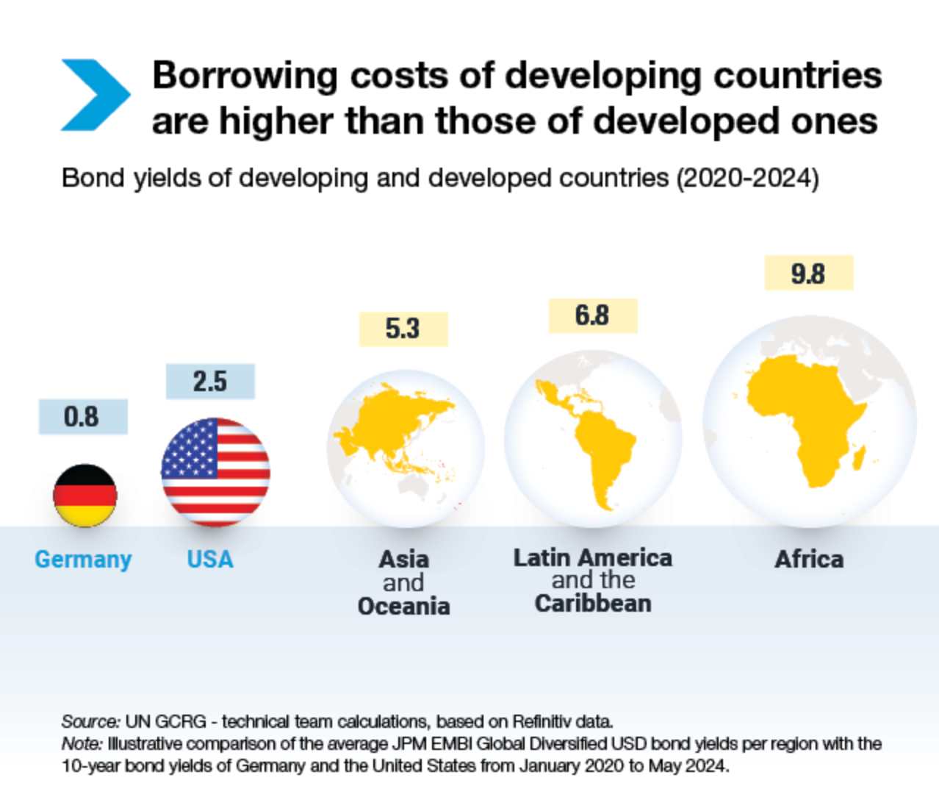
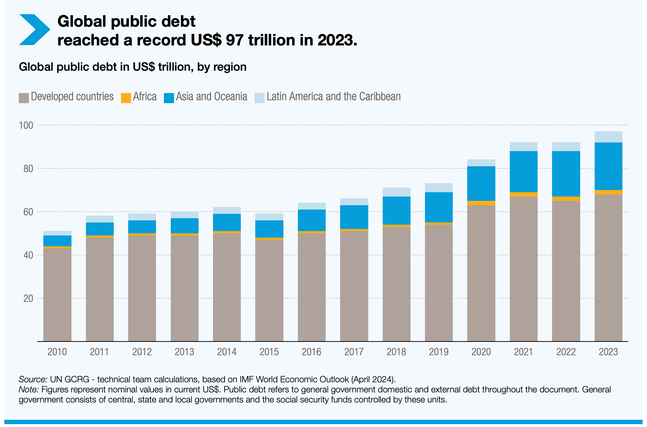
Total global public debt is $97 trillion
Total debt stock in 2023 was $670bn
Africa just a sliver @ 2%
Debt service in Africa was $88bn
9x higher than Germany
So huge savings potential if derisking possible
3.3 billion people live in countries
where debt service costs are
higher than health & education
2022: developing countries paid $49 bn
more to external creditors than new
disbursement, i.e. net outflow

Slide 5
Problem statement: “The causes of these crises vary, but at a fundamental level they all share a common feature: the gross misallocation of capital. During the last two decades, much capital was poured into property, fossil fuels and structured financial assets with embedded derivatives. However, relatively little in comparison was invested in renewable energy, energy efficiency, public transportation, sustainable agriculture, ecosystem and biodiversity protection, and land and water conservation.” (UNEP, Green Economy Report, 2011:14)
The question we hear most often: why have we not been able to bend the curve? Answer: because we have not paid enough attention to finance in general, and allocation of capital in particular
Assessment reports and the bulk of the academic literature on sustainability has ignored finance. There is no finance SDG. CGE models exclude finance. Why? Because finance is seen as a mere intermediary. But this is not, in fact, a true reflection of reality.

Slide 6
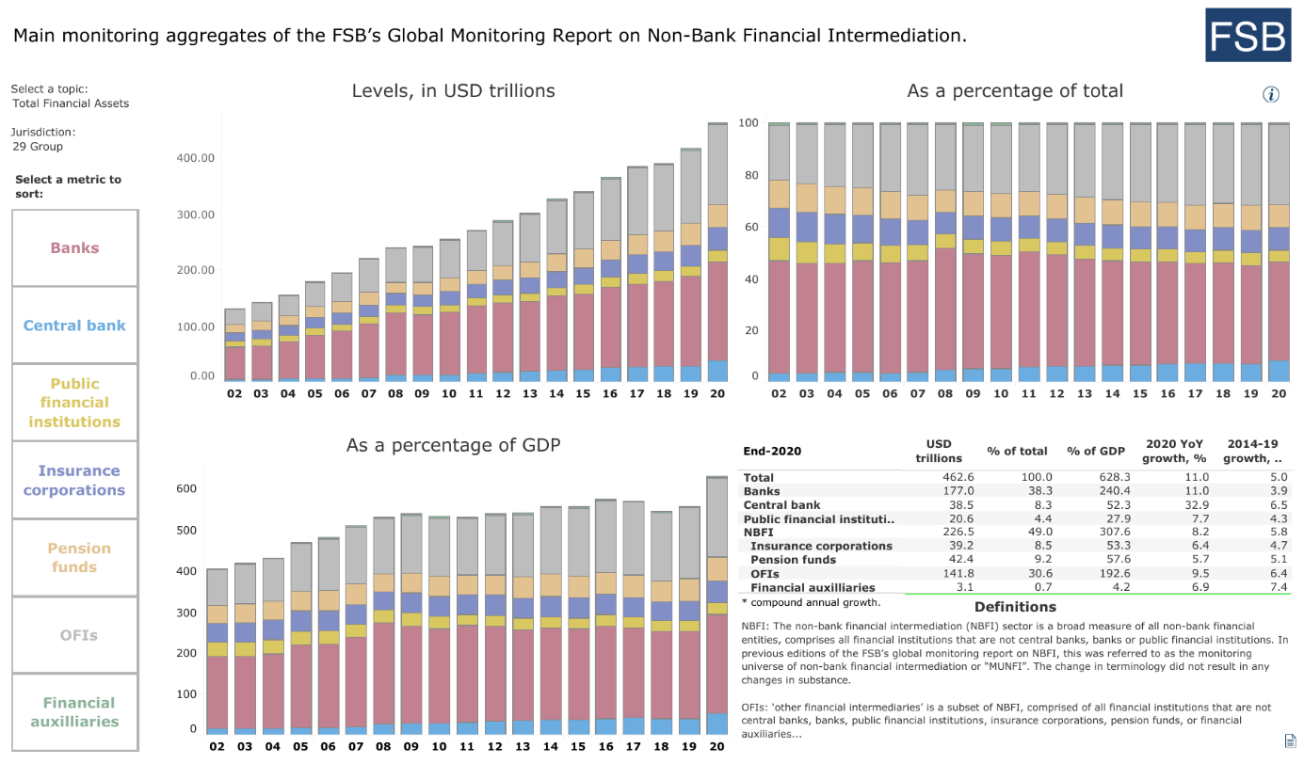
Source: FSB 2021
Finance has decoupled from the real economy

Slide 7

“I believe we are on the edge of a fundamental reshaping of finance“ – Larry Fink, CEO of Black Rock, 2020
“[A] new, sustainable financial system is under construction.” – Mark Carney, Governor of the Bank of England, 2019
Former Chairman of
the Financial Services
Authority, UK, 2008-13
“Banks which can create credit and money to finance asset price booms are thus inherently dangerous institutions.“

Slide 8
Transfers?

Slide 9
Ecological Unequal Exchange:
“North”: high income (according to WB) countries. “South”: the rest
Raw materials: 24-43% of resources extracted in the South are consumed in the north (including biodiversity)
20% of all land in the south embodied in goods consumed in the north (including biodiversity)
28-38% of all labour in the south deployed in the production of goods consumed in the north
10% of energy generated in the south embodied in goods consumed in the north
Northern consumption is unsustainable (27 t/c vs 6 t/c), 25% of which is appropriated
Significantly, 25% of the Global North consumption is effectively procured for free due to structurally determined unfair compensation for Global South resources — or, put simply, paying the Global South less than the real value of the goods extracted in and imported from the Global South

Slide 10
Commodity trading: the finance-resource nexus
Who manages trade in resources?
75% - 90% of grain traded by 4 agricultural commodity traders – Archer Daniels Midland (ADM), Bunge, Cargill and Louis Dreyfus
50% of OPEC’s oil: 3 commodity traders – Vitol, Glencore and Trafigura;
Glencore controls 55% of the global zinc market and 36% of the global copper market (HQ: Zug);
Wilmar accounts for 45% of the world trade in palm oil
Buyers and sellers of world’s commodities – previously via non-profit exchanges, now for profit
Increasingly concentrated
Increasing financialization: value of traded copper derivatives to copper production (London Metal Exchange)
  40:1 in 1982
  2000:1 by 2014
More profitable than Wall Street Banks
(Sources: Nissanke, 2010; Seddon, 2020; Baines & Hager, 2021)
Revenues in 2019: Vitol (Dutch, private) - $225 bn; Glencore (Switzerland) - $215 bn; Trafigura (Dutch) - $171.5 bn; Mercuria (Switzerland) - $121 bn; Cargill (USA, private) - $113 bn; COFCO (China) - $72 bn; ADM (USA) - $64 bn; Wilmar (Singapore) - $42.6 bn

Slide 11
Finance is decoupled from the real economy
1960s: value of financial assets - 30-50% of GDP (Turner, 2016)
2020: value of financial assets - 628% of GDP (FSB, 2021)
Since the 1980s: trading grew faster than exports/imports; trading in commodities faster than the production of commodities; capital flows between countries faster than investment in the real economy. (Turner, 2016)
In short, GDP growth rates driven more by finance than primary or secondary sectors
1971: end of the Bretton Woods agreement on gold reserves - after dropping of the gold standard in 1971 and oil crisis in 1973, banks deregulated and become primary creators of money, and Central Banks seized control of monetary policy to drive down inflation which benefits debt issuers & providers (Tooze, 2020).

Slide 12
Why is finance decoupled from the real economy?
  Petro-dollars fund the first wave of neo-liberalism (1970s/80s)
  Rise of China and Chinese surpluses via bonds and lending against real estate (‘90s/2000s)
  Post-2007/post-pandemic: QE – Central Banks pump money for recovery/stabilisation
  Trump era: weaponization of tariffs and US $, warfare, de-dollarization, Chinese dominance
  Note: all three underpinned by unequal exchange. But where is the next global flow going to come from? Deepening unequal exchange? More resource wars? Is Ukraine the start of a spate of regional resource wars with global impacts?
  This is how to understand Donald Trump: create a new financial flow in favour of the USA! Devalue the US$ but ensure the dollar remains the global currency

Slide 13
Inequality in the heartland (USA)
Returns to shareholders rise since the 1980s, while returns to labour declines
1979 – 2005: income of top 1% increases by 58%; top 0.1% by 67%
1978 – 2020: average wage of workers increased by 18%
CEO salary increases higher than increases in share values:
  CEO salaries 1978-2020: 1322%
  S&P stock market growth 1978-2020: 817%
(Sources: Bakija, Cole & Heim, 2010; Tooze, 2018; Mazzucato, 2018; Mishel & Kandra, n.d.)

Slide 14
Legitimizing premises:
Economies tend towards equilibrium means denying economies are embedded within societies and ecologies (Swilling, 2020)
Banks are merely intermediaries means denying they are the creators of money (i.e. it is not deposits that create loans, it is loans that create deposits) (Werner, 2016)
Inflation is the enemy, use interest rates to ‘beat inflation’: means denying the socio-economic impact, and the transfer of power from poor to rich (Werner, 2016; Tooze, 2020)
Development is best funded from foreign loans, and for that it is necessary to privatise, decentralise and deregulate (and unequal exchange is a myth) (Werner, 2016)
Financialisation of GDP in the 1990s, thus bringing financial transactions into the definition of ‘productive value’ (Assa, 2016)

Slide 15
New trends:
Index Funds: $3 trn in 2007; $15 trn by 2021 –
  Top 3 (Black Rock, Vanguard, State Street) - 34% of S&P 500 by 2028
  have an interest in the health of the economy as a whole
  Larry Fink’s 2020 famous letter to CEOs (triggered a reaction)
  But they mainly vote in favour of pro-FF resolutions at Board level
Sovereign Wealth Funds: $3.9 trn in 2007; $7.6 trn in 2018
  mainly ME and Asian – biggest is Norwegian SWF
  Recently adopting climate orientation/ESG procedures
  Norwegian SWF: screening the 9300 companies it invests in, divesting from FF
DFIs: 527 in 150 countries; $18.7 trn in assets; tripled in size since 2007
  shifting into sustainability
  Net Zero targets, investing in the just transition
Central Banks: $38.5 trn by 2020, massive growth since 2007 due to QE
  mandate shifted from inflation busting to monetary stimulus
  Now resisting rising interest rates due to increases in natural resource prices
  Mark Carney and BIS: Central Banks should be leading the way
  Network for Greening the Financial System (NGFS) - 90 Central Banks

Slide 16
Finance & transition
Climate finance: from $364 bn in 2011/12 to $632 bn in 2019/20 (50% from private sector)
Target: $4-5 trillion
Adaptation: $46 bn in 2019/20 – 53% up from previous year
Target: $155-330 bn
IMF: $1.6 trillion in ESG-related debt in 2021, 116% higher than previous year
4000 signatories of Principles for Responsible Investment
450 asset managers from 45 countries controlling $130 trn signed the Glasgow Financial Alliance for Net Zero
But:
1.8 million companies own 43 439 oil & gas assets, most with OECD shareholders
11 of the biggest EU banks own 520 bn Euros of FF assets – 95% of their equity
60 of the world’s biggest banks invested $4.6 trn in FF assets since 2015
Sources: (Buchner et al., 2021; Institute Rousseau, Les Amis de la Terre France & Reclaim Finance, 2021; Galaz & Collset, 2022; Reclaim Finance, 2022)

Slide 17
 | Green >>> increasing
Red: Social Increasing<<< | Light Green | Dark Green
 | Light Green and red | Dark-green and red
fundable within existing financial eco-system
‘Fit and conform’
‘stretch and transform’
(Source: adapted from Spratt, 2015)

Slide 18
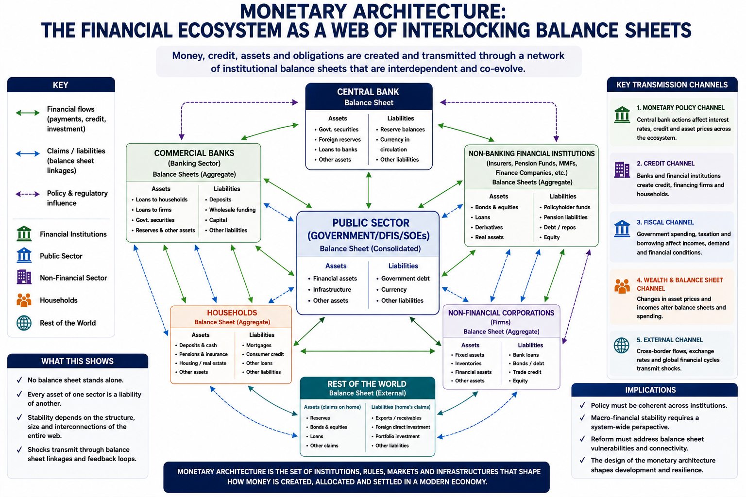

Slide 19
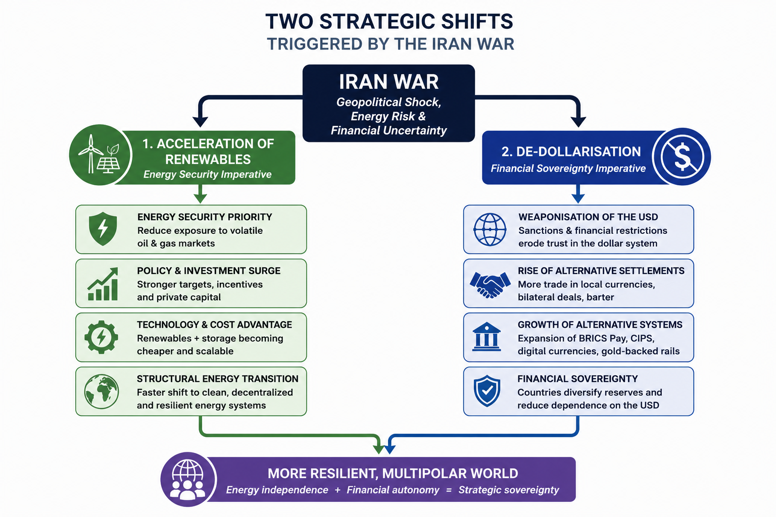
But as long as the bulk of
Debt remains denominated
In USD, maybe too early to
Talk about de-dollarization?

Slide 20
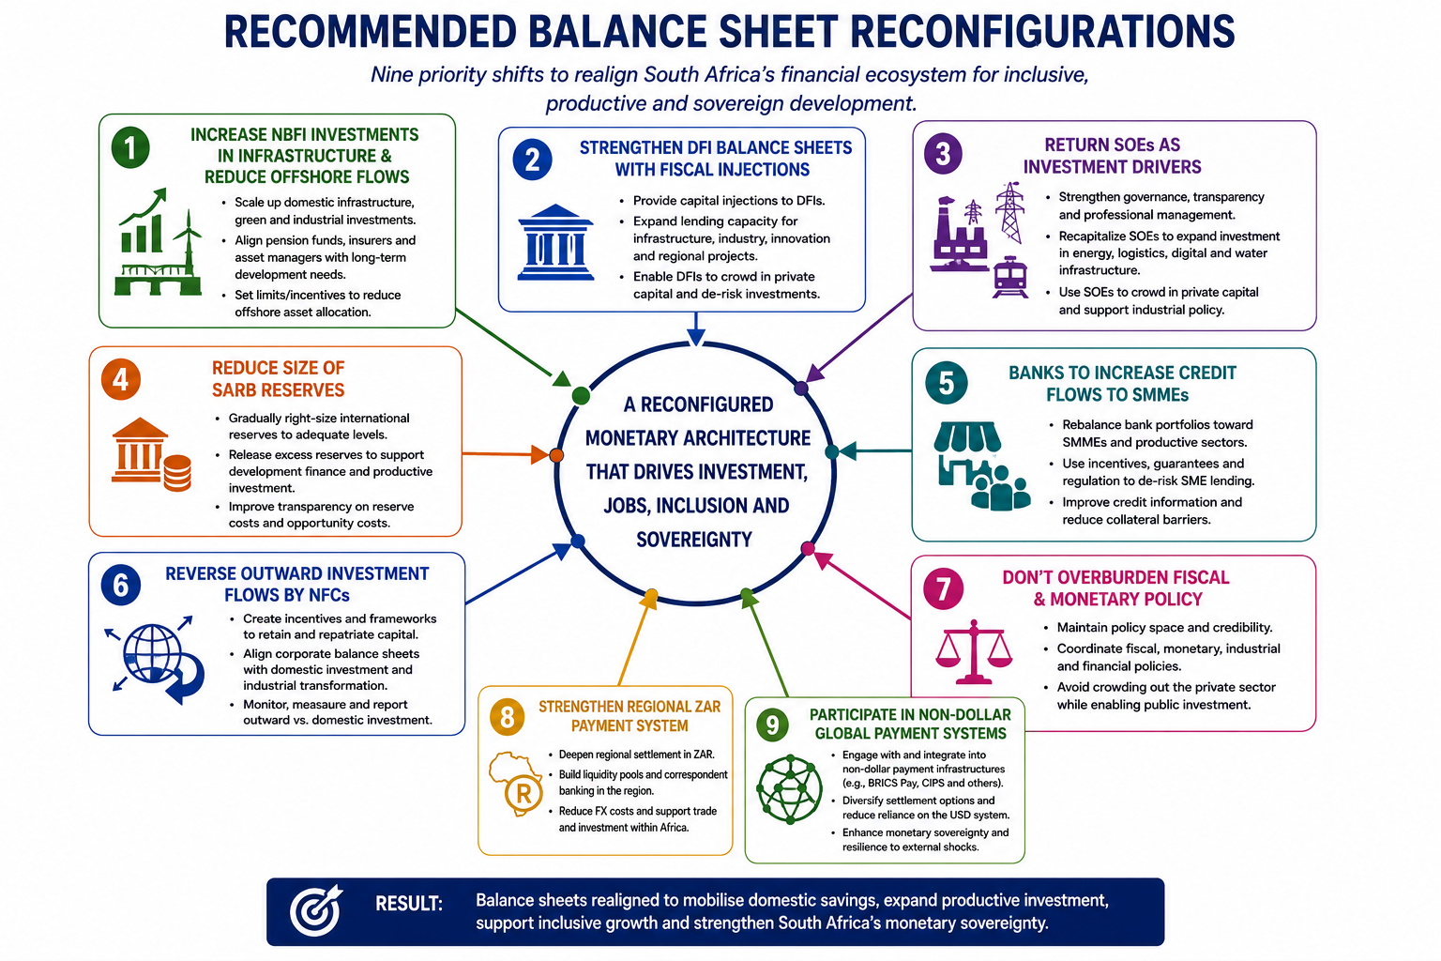

Slide 21
Global and South Africa’s
Energy Transition

Slide 23
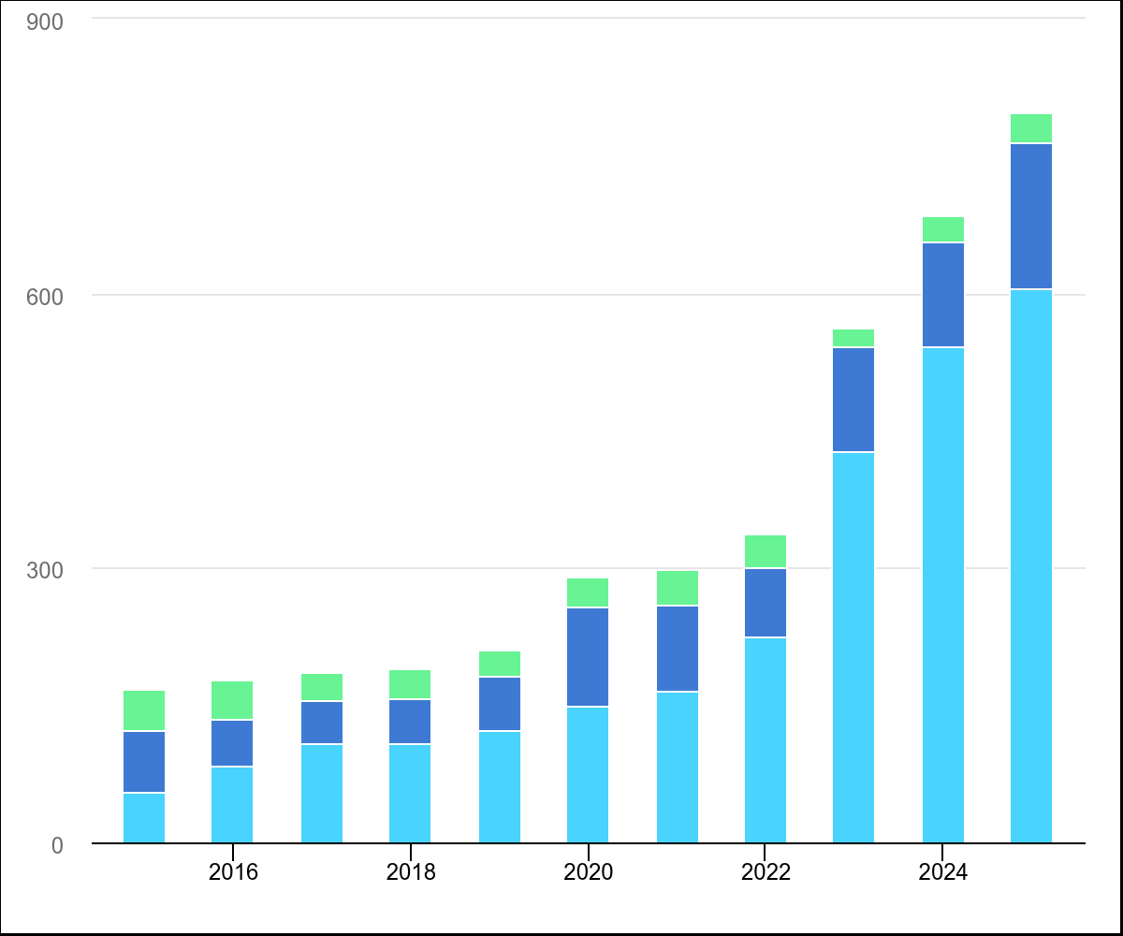

GW
Total renewable capacity additions by technology, 2015-2025 (Source: IEA)

Slide 24

(Source: IEA)

Slide 25
(Source: IEA)

Slide 26
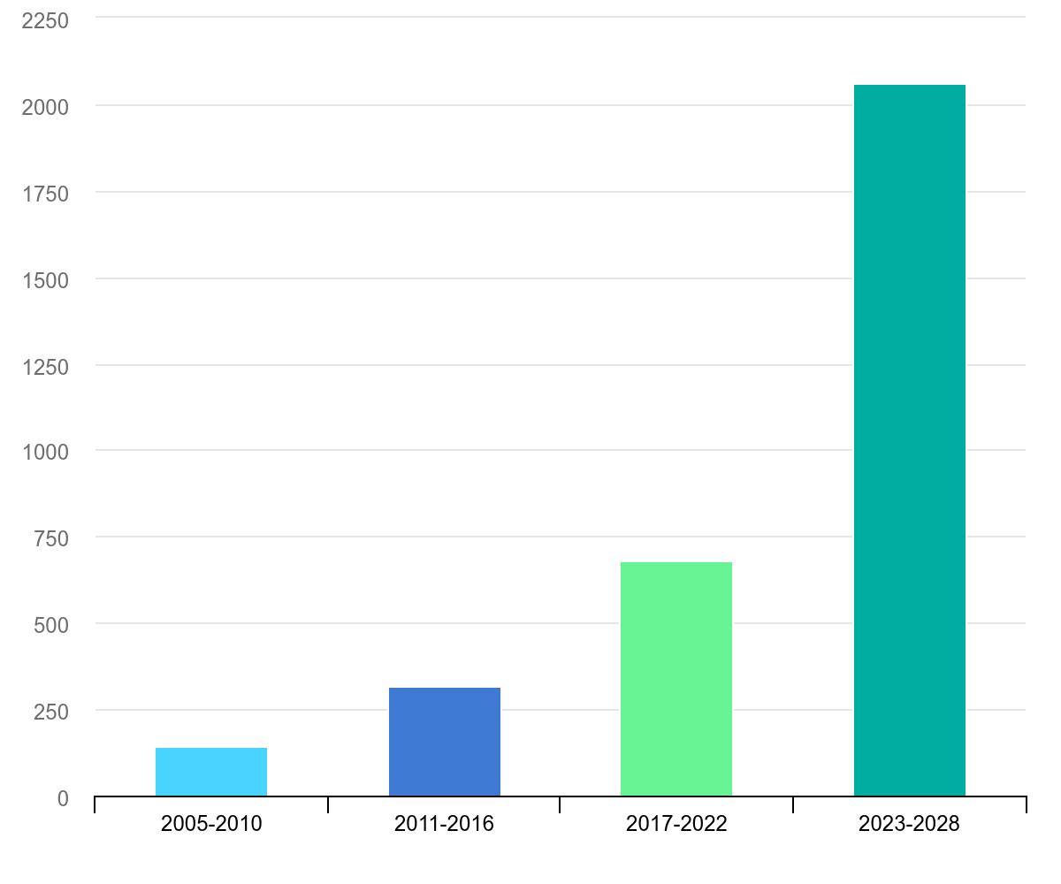
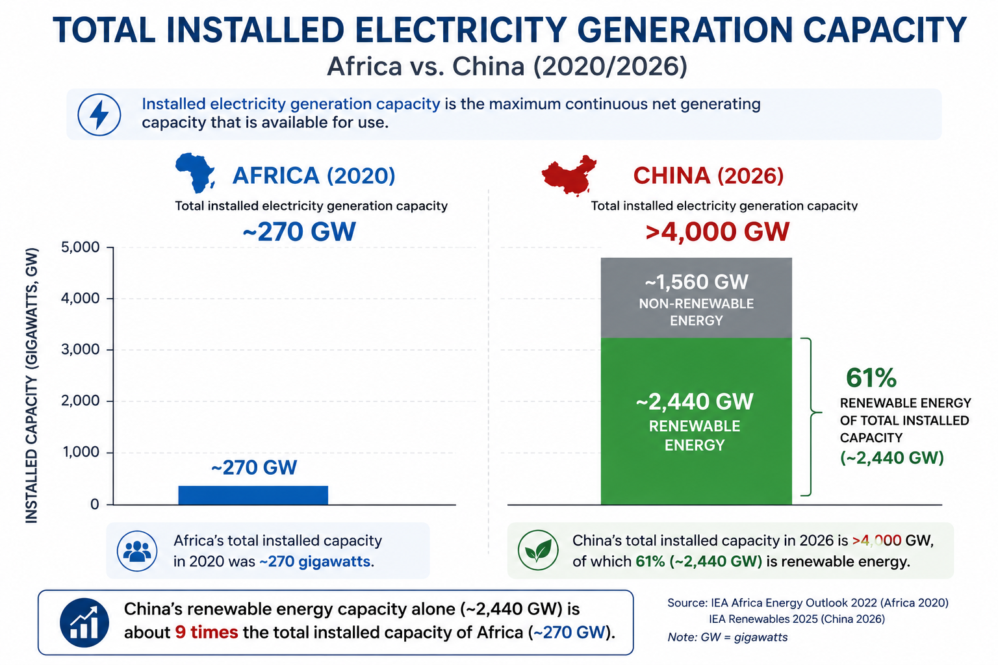
GW
Renewable electricity capacity growth in China, main case, 2005-2028 (Source: IEA)

Slide 27
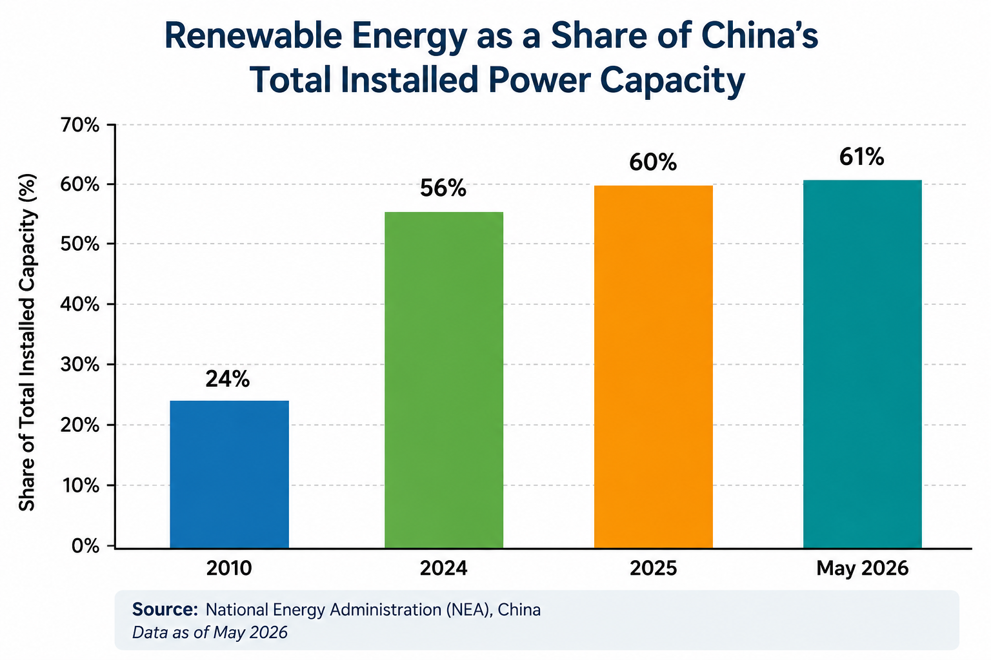

Slide 28
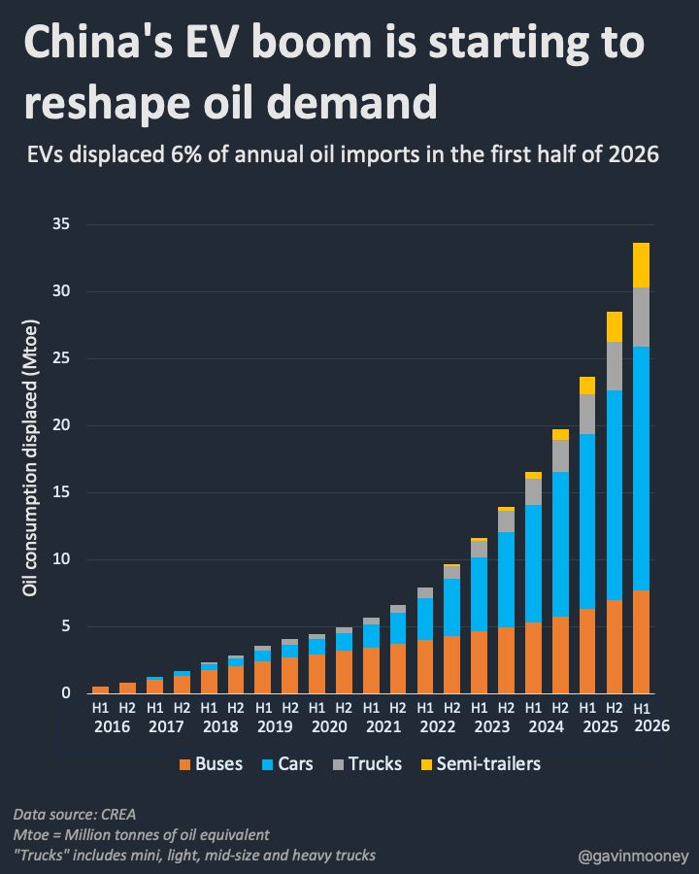
That converts to around 1.35 million barrels per day – more than 1% of total global oil demand.

Slide 29
SA’s energy system – the basics
Generators: coal power stations, gas, hydro, RE
Transmission
Distribution: Eskom Distribution delivers 50% & Municipalities deliver 50% (256, 50% deliver electricity)
Transitioning from a unitary to an unbundled system (Eskom, plus NTCSA – transitioning to TSO)
Renewables: from 2011, hiatus from 2015 to 2019, 2020 ->
Regulation: NERSA
Political accountability: from DMRE to DoEE

Slide 30
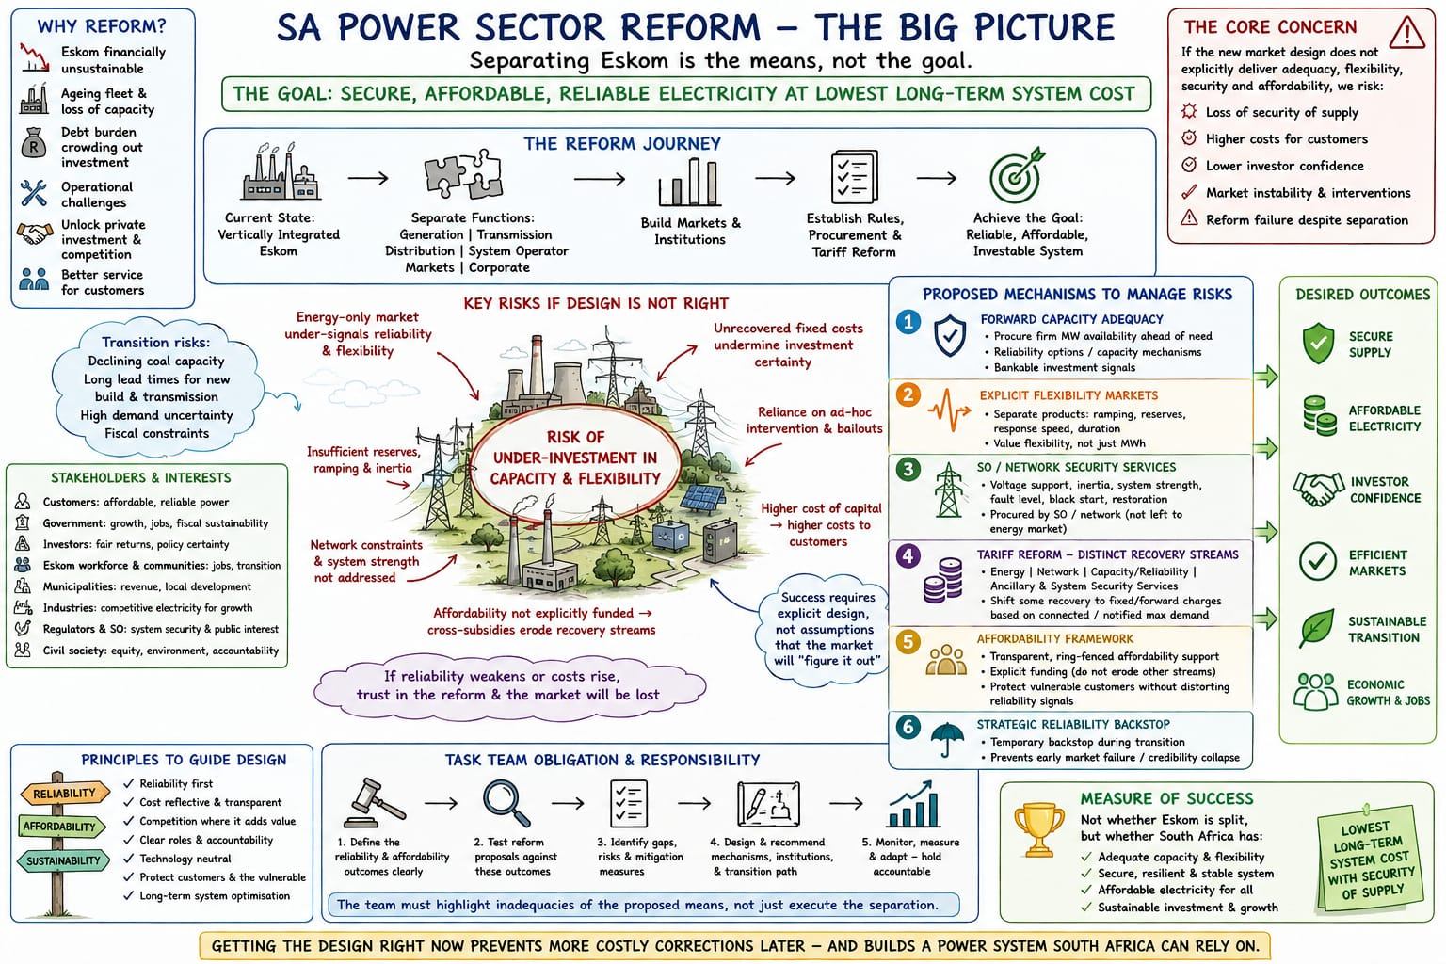
(Source: Ronald Marais, NTCSA)

Slide 31
Current Mix, Future Demand
Figure 3: the mix of technologies that are currently deployed to deliver the electricity consumed in 2024. Coal
dominates the mix (81%), renewables are still low (7%). Figure 9: the projected growth in demand (total and
per Province) through to 2050 from the current 250 000 GWh, to nearly 450 000 GWh.
37 GW
4 GW
2 GW
13 GW
4 GW
Total: 60 GW
Note: KW, MW or GW refers to kilo-, mega- or giga watts of installed capacity, the size of the generation plant.
No plant works at maximum capacity all the time. This means each plant generates electricity over a period of time,
such as hourly, daily, weekly, monthly, yearly. This is measure in kilowatts per hour (KWh), or megawatts per
hour (MWh), or gigwatts per hour (GWh), or terawatts per hour (TWh). Always make sure you make clear what is
being referred to or what you are talking about. Both Figures 3 and 9 are in TWh, i.e. the amount of electricity
actually generated in 2024 from different technologies, to the amount needed in future in different provinces.

Slide 34
Key elements of SA’s energy system:
Coal-based – 15 coal-fired power stations, the most coal intensive economy in the world
Ageing coal-fired power stations – average age is 42 years. Energy Availability Factor (EAF) – slowly improving from a low of 50% to ave 65% in FY2026. R90 bn spent on keeping the old coal-fired power stations going. EAF supposed to improve to 70% - only possible when old power stations close. But might continue to improve.
7 coal-fired power stations must close by 2030, an additional 2 by 2035. 15 GW of coal power needs 57GW of RE to replace this. (Nuclear will take too long, and gas probably as well)
Alternative: an affordable technology mix drawn from: gas as ‘baseload’ and/or backup only, nuclear, hydro, solar+batteries/gas, wind+batteries/gas, plus ‘energy efficiency’, flexibility
REI4P: renewable energy independent power producers procurement programme
Renewables: +6 GW via REI4P, + 6 GW rooftop solar, 31 GW in the pipeline, ie with BQs (‘embedded generation’ – mainly large companies) = 43 GW of RE (all models estimated 30GW by 2030). Assume 75% success – 32 GW.
Grid is key constraint: Transmission Development Plan (TDP) – R400 bn over 10 years, 14 400 Kms of lines, 270 sub-stations – largest capex project since 1994. Role of NTCSA. ITP Programme launched
Structure: generation (Eskom), transmission (NTCSA), distribution (Eskom distribution plus municipalities) -NEDSA
Distribution (supply to consumers): for 50%, supplied by Municipalities who, in turn, buy from NTCSA; other 50% supplied directly by Distribution who buy from NTCSA. Municipal systems collapsing – massive debts to Eskom
Municipal debt: R110 billion, 95% from non-metros – only 10% of non-metro municipalities responsible for most
RE is generated by private companies, and procured via the IPPO via Bid Windows (auctions)

Slide 35
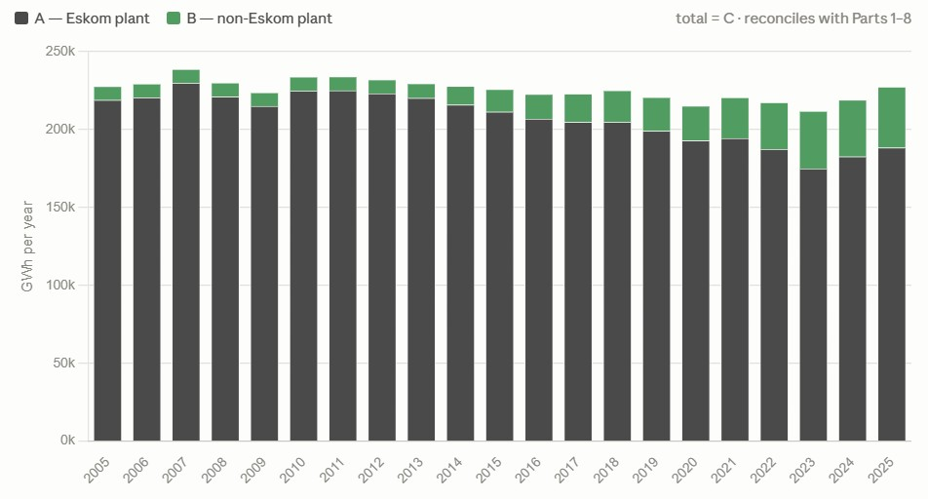
Nett electrical energy generated in SA per year from 2005-2025 – by Eskom and non-Eskom generators – showing the split per year in absolute energy (GWh) terms

Slide 36
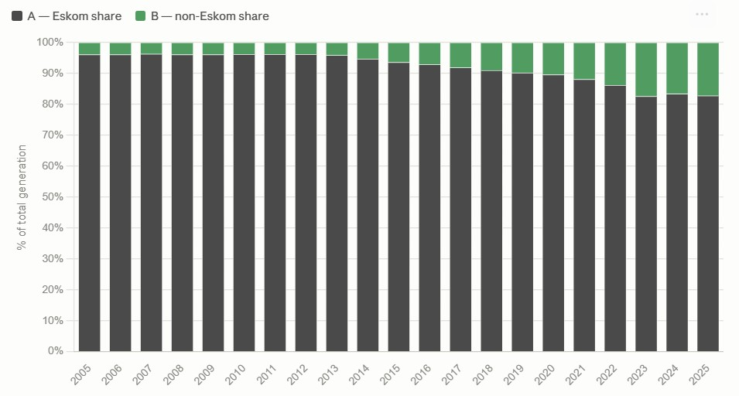
Net Electrical Energy Generated in South Africa, 2005-2025, by Eskom and Non-Eskom Generators (%)

Slide 37
Key policy documents:
Integrated Resource Plan: 2019, IRP 2023 (draft), IRP 2024 (draft), IRP2025 (DMRE, and DoEE since 2024 election)
Energy Action Plan 2022 (updated ) – The Presidency
Transmission Development Plan (NTCSA)
Nationally Determined Contribution (DEFFE)
Just Transition Framework (PCC, Cabinet)
South African Renewable Energy Masterplan (DoEE, 2025)
National Infrastructure Plan 2050 (2022)
Climate Change Act (2024)
Electricity Regulation Amendment Act (2024)
Low Emission Development Strategy (2020)

Slide 38
Technologies
Coal: coal-fired power stations burn coal in a boiler to produce high-pressure steam - steam spins a turbine connected to a generator, producing electricity. Steam is cooled, condensed, and reused, while exhaust gases are filtered before release into the atmosphere.
Coal-CCS: CCS = carbon capture and storage. Viable technology, but expensive and so not commercially viable on scale.
Nuclear: conventional and ‘small modular reactors’ (SA technology, one plant in China, not commercially viable unti 2035)
Natural gas-Open Cycle Gas Turbine (NG-OCGT): air is compressed, mixed with fuel (usually natural gas), and burned. The hot gases spin a turbine connected to a generator to produce electricity. Quick to start up, use for peaking only.
Natural Gas-Combined Cycle Gas Turbine (NG-CCGT): same as NG-OCGT, except the hot gasses release in OCGT are captured and used to generate steam, which powers a second (steam) turbine. (Slower to start up, can be used for baseload)
Natural Gas-Internal Combustion Engine (NG-ICE): similar to a diesel engine but uses gas. Useful for backup power. Smaller scale.

Slide 39
Pumped hydro storage (PHS): water from a dam or river drives a turbine that generates electricity.
Solar Photovoltaics (Solar PV): sunlight translated into electricity via photovoltaic cells made from silicone
Wind: windmills that drive mini-turbines that generate electricity.
Battery Energy Story Systems (BESS): batteries made from lithium or vanadium to story energy for release when needed.

Slide 40
LCOE (‘levelized cost of energy’ globally as per Lazzard report – total cost of building & operating the plant over the life cycle of the plant measured in cost per MWh) – 2024 and 2025 figures
Solar PV (utility scale): $29-$92 // $33-$44 (double with 3 hour battery storage)
Solar rooftop: $122 - $249
Wind (onshore): $37-$73 // $37-$66
BESS: $132 in 2025
Coal: $69-$168 // $109 - $157
Nuclear: $142-R222 // $141-$251
Gas peaking: $110-$228 // $48-$109
(LCOE does not include indirect costs, e.g. batteries for RE, carbon taxes for fossil fuels, grid costs to enable connection to the grid, insurance costs related to nuclear)

Slide 41
Cost of capital impacts – 2 scenarios
the low-cost scenario: assumed a WACC of 5.4%, cost of equity at 8% and cost of debt at 6%
high-cost scenario: assumed a WACC of 10%, cost of equity of 16%, and a cost of debt at 10%.
Nuclear: high-cost scenario rises by 52% compared to the low-cost scenario (i.e. from $148/MWh to $226/MWh)
Solar PV (utility scale) in the high-cost scenario only rises by 23% compared to the low-cost scenario (i.e. from $69/MWh to $85/MWh)

Slide 42
Three scenarios:
International pathways:
Aligned: alignment with Paris Agreement on
preventing warming by more than 1.5 d
Fragmented response – some taking action,
others not (2-3 degree warming)
BAU – world according to Trump – ‘drill baby
drill’, climate denialism
South Africa’s pathways:
Green industrialisation – 2 GT carbon
budget (ambitious end of NDC), strong
commitment to energy transition, cheap
finance
Market forces: 3 GT carbon budget, weak
commitment to energy transition, some
cheap capital
BAU: no carbon budget, climate denialism,
constrained decarbonisation
In sum: world according to Trump, plus SA
according to pro-coal lobby is the worst scenario
Are there other scenarios? E.g. BAU, while SA
greens (top right)? Or 1.5 d world, while in SA
climate denialism becomes the norm (bottom
Left)?

Slide 43
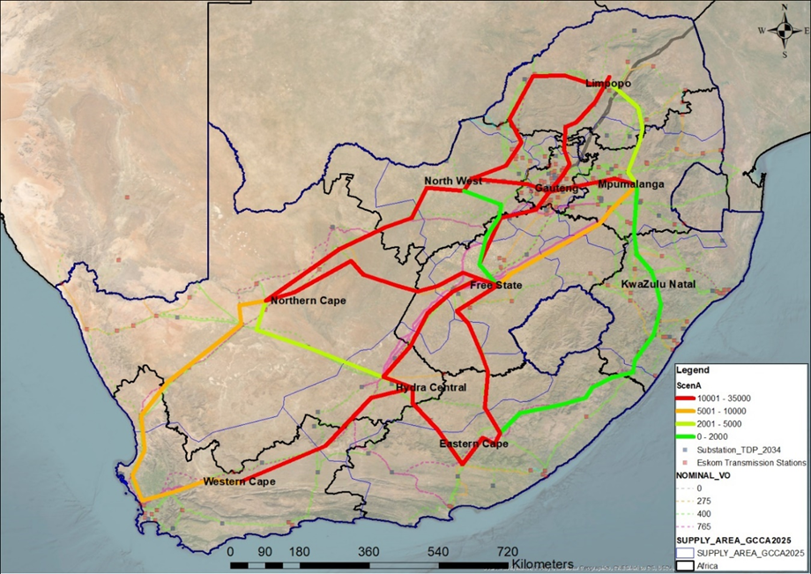
Transmission Corridors –
R400 billion
14 400 Kms
270 transformers

Slide 44
Energy Mix
 | Scenarios | Solar and Wind plus battery storage | Gas | Coal | Nuclear | Hydro | Carbon Budget (2023 – 2050)
2024 - 2030 | A: Green Industrialisation | 60GW | 9GW | 14GW | 2GW | 4GW | 2,1 GT
 | B: Market Forces | 34GW | 7GW | 34GW | 2GW | 4GW | 3,1 GT
 | C: Business-as-usual | 35GW | 5GW | 34GW | 2GW | 2GW | 4,5 GT
2031 - 2050 | A: Green Industrialisation | 200GW | 23GW | 10GW | 2GW | 5GW | 2,1 GT
 | B: Market Forces | 130GW | 26GW | 10GW | 2GW | 5GW | 3,1 GT
 | C: Business-as-usual | 109GW | 29GW | 11GW | 2GW | 5GW | 4,5 GT
Note: for each period, the model results for each set of technologies are presented in Gigawatts for each scenario,
i.e. installed capacity and not output in GWh. For example, 60 GW of RE+storage for the green scenario by 2030, and
Another 200 GW by 2050. Coal drops from 37 GW today to 14 GW by 2030, and to 10 GW by 2050. Total carbon
emissions are then calculated for each scenario in far right column.

Slide 45
Total investment requirement:
Scenario | Total Generation Capex | Total Generation Opex | Total Grid Capex | Total investment required | Average annual investment
Scenario A | R1 651 bln | R1 552 bln | R383 bln | R3 586 bln | R138 bln
Scenario B | R1 229 bln | R2 166 bln | R262 bln | R3 657 bln | R141 bln
Scenario C | R1 446 bln | R2 490 bln | R231 bln | R4 166 bln | R160 bln
Notes: (a) Most of these kinds of modelling exercises focus on capex, i.e. the cost building an electricity plant, whether
RE, or coal, or nuclear. However, a coal plant needs to be fed continuously with coal which is not in the capex – it is in the
opex. So, both capex and opex must be calculated to arrive at total system investment requirements. Nuclear, solar
and wind do not require continuous fuel inputs. Also, there are two kinds of opex costs: Fixed Operations & Maintenance
(FOM) and Variable Operations & Maintenance (VOM). FOM is unaffected by output, and VOM is related to output.
(b) Also, usually only generation is taken into account, ignoring the grid costs. (c ) Scenario A (green industrialisation) is
the cheapest. Why? No need for paying for the energy input (sun, wind) – this is true for nuclear too. But the capex for
RE is much lower than nuclear.

Slide 46
Decommissioning Scenarios:
Pathway 1: IRP 2019
Pathway 2: delayed decommissioning
relative to Pathway 1
Pathway 3: accelerated
Decommissioning relative to
Pathway 1
Even though it makes sense to use
Pathway 3 to model Scenario A,
Pathway 1 was used, which still
means closing 9 plants by 2050.
Komati is the first to close, others
are winding down (e.g. Hendrina)
Baseload: best use of a coal plant to ensure longer life is constant level of output 24/7, not at maximum capacity.
This is called ‘baseload’. To plan & build a coal plant can take 10 yrs – thus demand for baseload must be assumed
well in advance. Hence, supply-driven planning. A RE plant can be planned & commissioned in 2 years. Demand-
driven planning therefore becomes possible. Baseloadism falls away. Entire system becomes flexible – supply follows
demand.

Slide 47
Note: Figure 29 reveals the estimated CO2 emissions per scenario. The brackets refer to the emissions targets of South Africa’s National Determined Contribution (NDC) to the UNFCCC process, i.e. between 180 Mt/a and 125 Mt/a by 2030. This diagram shows that only Scenario A (green industrialization) hits the bottom end of the desired target range by 2030 and nearly net zero by
2050 which is the NDC target. Scenario B does not get us close to net zero, and Scenario C does not even hit the bottom end of
the 2030 target.

Slide 50
(Source: Ronald Marais, NTCSA)

Slide 51
NTCSA: infrastructure
33 199 km of high-voltage transmission lines – TDP: 14 400
159 384 MVA of three-phase transformer capacity -
169 transmission sub-stations
374 long-distance transmission lines that make up the national grid that all of South Africa depends on for electricity supply
332 generation projects underway, that will generate 31 GW that, in turn, will require grid connections by 2030
Source: Eskom (2026) State of the System – 2026 Winter Outlook Briefing. https://www.eskom.co.za/wp-content/uploads/2026/04/State-of-the-System-%E2%80%93-Winter-Outlook-Briefing-2026.pdf?utm_source=chatgpt.com [Accessed: 19 July 2026]

Slide 52
NTCSA: approved financials
NERSA approved financials for the year 2026:
Revenue generated from sale of electricity to Eskom Distribution (who supply the municipalities), major energy users, traders, Southern African utilities and metropolitan governments: R112 billion, R138 billion and R169 billion respectively for FY2026, FY2027 and FY2028.
Capex: R20 billion, R36 billion and R39 billion respectively for FY2026, FY2027 and FY2028 to cover strengthening and expansion (R75.8 billion), asset replacement/refurbishment (R15.3 billion), EIAs and servitudes (R3.6 billion), production equipment (R1.3 billion).
Return on Assets (RoA): R4.4 billion, R6.9 billion and R10.1 billion respectively for FY2026, FY2027 and FY2028.
Number of employees: around 4500
(Source:National Energy Regulator of South Africa (2025) In the matter regarding The National Transmission Company South Africa (NTCSA) Multi-Year Price Determination (MYPD6) Revenue Application. https://www.nersa.org.za/files/files/2025/06/MYPD6DecisionandReasonsforDeision-NTCSA.pdf [Accessed: 19 July 2026])

Slide 53
Transmission Development Plan
TDP targets: 14 400 Kms of lines and 271 transformers need to be constructed between 2025 and 2034.
Annual average:1400 Kms of lines. FY 2023/24: 74 Kms of lines built. FY 2024/25: 293 Kms built. Target for FY 2025/26: 423 kms, but 270.8 Kms built.
Targets for FY 2027/28, FY 2028/29 and FY2029/2030 are 550, 1662 and 2122.
Total by 2030: 4604.8 Kms - just below TDP targets and this is what is required to connect the 31 GW of renewables with BQs.
(Source: Eskom - State of the System, op. cit. )

Slide 54
Investment
TDP is costed at R400 billion (14 500 kms of lines plus 210 transformers), and given that around
5000 kms of lines plus 87 transformers planned for 2025-2029/30 (i.e. one third of the total)
Therefore: NTCSA’s expected capex for this period should be between R150 and R175 billion, i.e. R30-R35 billion per annum.
2026 State of the System report: 7.7 GW of the new 31 GW already operational, 5.7 GW is being executed, 2.8 GW have Budget Quotes (which means they are approved for execution), and 15.4 GW are what NTCSA refers to as in “BQ Development”.

Slide 55
Source: Ronald Marais, 2026)

Slide 56
Source: Ronald Marais, 2026)

Slide 57
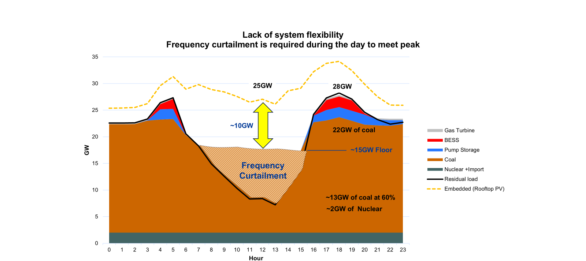
Source: Ronald Marais, 2026)

Slide 58
Unbundling
Eskom Roadmap 2019
NTCSA established: 2024
ERAA: 2025 – establishment of the TSO by 2030
End 2025: Eskom/DEE position – NTCSA remains Eskom subsidiary with the assets, new entity created as TSO (no assets)
SONA in Feb 2026: TSO must be “fully independent” (i.e. with assets), ERTT established, and final report completed

Slide 59
Unbundling options:
Eskom’s ISO model: NTSCA remains asset owner & Eskom subsidiary, with a separate ISO (SO, MO, CPA)
TSO model: NTCSA is converted into the TSO, (SO, MO, CPA, transmitter, asset owner)
TSO plus ISO: TSO is just an ISO (SO + MO), with 1 or 2 entities in future for the CPA, and asset owner.
Key issues: Eskom must not be left worse off, and TSO must not be burdened with debt
Assets valued at anything between R80 and R140 billion.
No matter which option, key issue is tariff reform

Slide 60
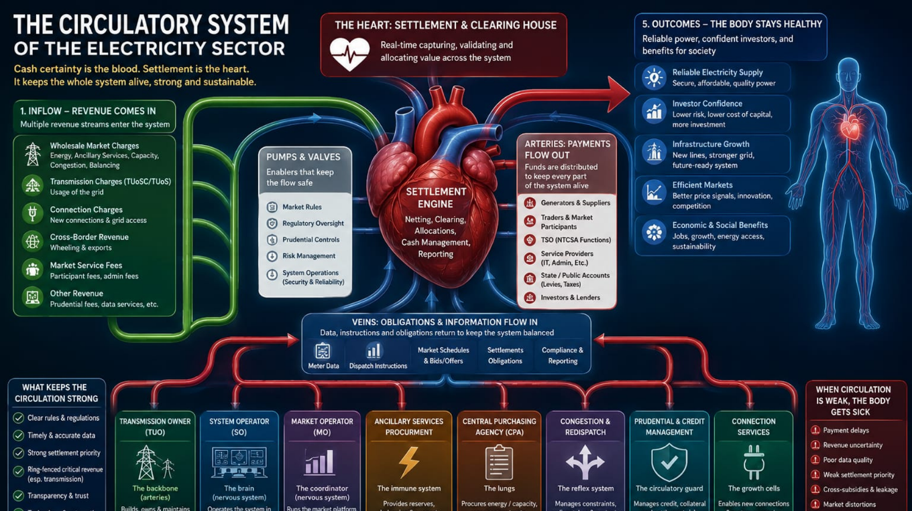
Source: Ronald Marais

Slide 61
Recoupling finance to the real economy – key to allocating capital to fund transition:
Campaigns against unequal exchange (‘my luxury is your suffering’)
Support for global South countries in trade negotiations
Clamp downs on ‘capital flight’, not just by authorities, but by ‘enablers’
Activist interventionist role for Central Banks to restructure banking sectors
Expanded role for DFIs (including fiscal transfers, and enabling policy)
Expansion and re-orientation of SWFs
Index funds: adjust the algorithm, support oppositional nominees to Boards
Proliferation of community/non-profit/cooperative banks
Re-regulation/definancialisation of commodity traders
Divestment from FF and a solution to ‘stranded assets’
‘resource nationalism’ in the South
Definancialization of GDP

Slide 62
Sources:
Assa, J. 2016. The financialization of GDP and its implications for macroeconomic debates. New York: The New School for Social Research, Working Paper 10/2016.
Baines & Hager. 2021. Commodity Traders in a Storm: Financialization, Corporate Power and Ecological Crisis. Review of International Political Economy. DOI: 10.1080/09692290.2021.1872039.
Buchner, B., Naran, B., Fernandes, P., Padmanabhi, R., Rosane, P., Solomon, M., Stout, S., Strinati, C., et al. 2021. Global Landscape of Climate Finance 2021. London: Climate Policy Initiative. Available: https://www.climatepolicyinitiative.org/wp-content/uploads/2021/10/Full-report-Global-Landscape-of-Climate-Finance-2021.pdf.
Carney, M. 2019. Fifty Shades of Green. Finance and Development. (December 2019):12–15.
FSB. 2021. Global Monitoring Report on Non-Bank Financial Intermediation 2021. Available: https://www.fsb.org/wp-content/uploads/P161221.pdf [2022, August 03].
Galaz, V. & Collset, D. Eds. 2022. Economy and Finance for a Just Future on a Thriving Planet. Stockholm: Stockholm Resilience Centre.
Gallopin, G. 2003. A Systems Approach to Sustainability and Sustainable Development. Santiago: Economic Commission for Latin America.
Hickel, J., Dorninger, C., Wieland, H. & Suwandi, I. 2022. Imperialist appropriation in the world economy: Drain from the global South through unequal exchange, 1990–2015. Global Environmental Change. 73:102467. DOI: 10.1016/j.gloenvcha.2022.102467.
Institute Rousseau, les Amis de la Terre France & Reclaim Finance. 2021. Fossil assets : the new subprimes ? Paris: Institute Rousseau, Les Amis de la Terre France & Reclaim Finance.
Manolis, J., Chan, K., Finkelstein, M., Stephens, S., Nelson, C., Grant, J. & Dombeck, M. 2008. Leadership: A New Frontier in Conservation Science. Conservation Biology. 23(4):879–886.
Ndikumana, L. & Boyce, J.K. 2022. On the Trail of Capital Flight from Africa. Oxford: Oxford University Press. DOI: 10.1093/oso/9780198852728.001.0001.
Nissanke, M. 2010. Issues and challenges for commodity markets in the global economy: an overview. In Commodities, Governance and Economic Development Under Globalization. M. Nissanke & G. Mavrotas, Eds. Basingstoke: Palgrave MacMillan.
Oberle, B., Bringezu, S., Hatfield-Dodds, S., Hellweg, S., Schandl, H., Clement, J., Cabernard, L., Che, N., et al. 2019. Global Resources Outlook 2019.
Reclaim Finance. 2022. Banking on Chaos Report 2022. Paris: Reclaim Finance. Available: https://reclaimfinance.org/site/en/2022/03/30/banking-on-climate-chaos-report-2022/.
Seddon, J. 2020. Merchants against the bankers: the financialization of a commodity market. Review of International Political Economy. 27(3):525–555. DOI: 10.1080/09692290.2019.1650795.
Spratt, S. 2015. Financing green transformations. In The Politics of Green Transformations. I. Scoones, M. Leach, & P. Newell, Eds. New York: Routledge. 153–170.
Swilling, M. 2020. The Age of Sustainability: Just Transitions in a Complex World. London & New York: Routledge Earthscan.
Tooze, A. 2020. The Death of the Central Bank Myth. Foreign Policy. May 13:1–23. Available: https://foreignpolicy.com/2020/05/13/european-central-bank-myth-monetary-policy-german-court-ruling/.
Turner, A. 2016. Between Debt and the Devil: Money, Credit and Fixing Global Finance. Princeton: Princeton University Press.
UNEP. 2011. Towards a green economy: pathways to sustainable development and poverty eradication. Nairobi: United Nations Environment Programme.
Werner, R.A. 2016. A lost century in economics: Three theories of banking and the conclusive evidence. International Review of Financial Analysis. 46:361–379. DOI: 10.1016/j.irfa.2015.08.014.

